Slide 1
Java como programar - Deitel
Acesso a Redes

Slide 2
18.4 Establishing a Simple Server Using Stream Sockets
Five steps to create a simple server in Java
  ServerSocket object
    Registers an available port and a maximum number of clients
  Each client connection handled with Socket object
    Server blocks until client connects
  Sending and receiving data
    OutputStream to send and InputStream to receive data
    Methods getInputStream and getOutputstream
      Use on Socket object
  Process phase
    Server and Client communicate via streams
  Close streams and connections

Slide 3
18.5 Establishing a Simple Client Using Stream Sockets
Four steps to create a simple client in Java
  Create a Socket object for the client
  Obtain Socket’s InputStream and Outputstream
  Process information communicated
  Close streams and Socket

Slide 4
18.6 Client/Server Interaction with Stream Socket Connections
Client/server chat application
  Uses stream sockets as described in last two sections

Slide 5
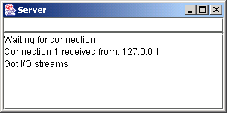
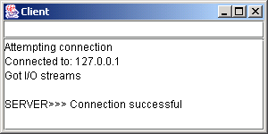

Slide 6
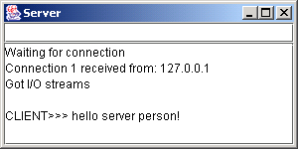
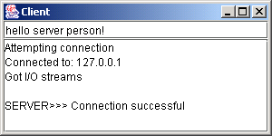
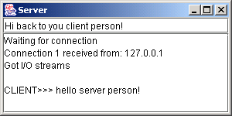
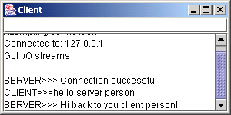
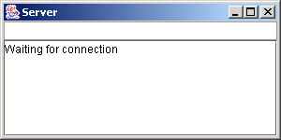
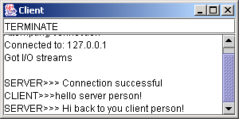
Client.java

Slide 7
Server.java
Lines 15-16
1 // Fig. 18.4: Server.java
2 // Set up a Server that will receive a connection from a client, send
3 // a string to the client, and close the connection.
4 import java.io.*;
5 import java.net.*;
6 import java.awt.*;
7 import java.awt.event.*;
8 import javax.swing.*;
9
10 public class Server extends JFrame {
11 private JTextField enterField;
12 private JTextArea displayArea;
13 private ObjectOutputStream output;
14 private ObjectInputStream input;
15 private ServerSocket server;
16 private Socket connection;
17 private int counter = 1;
18
19 // set up GUI
20 public Server()
21 {
22 super( "Server" );
23
24 Container container = getContentPane();
25
Listen on a ServerSocket; the connection is a Socket

Slide 8
Server.java
26 // create enterField and register listener
27 enterField = new JTextField();
28 enterField.setEditable( false );
29 enterField.addActionListener(
30 new ActionListener() {
31
32 // send message to client
33 public void actionPerformed( ActionEvent event )
34 {
35 sendData( event.getActionCommand() );
36 enterField.setText( "" );
37 }
38 }
39 );
40
41 container.add( enterField, BorderLayout.NORTH );
42
43 // create displayArea
44 displayArea = new JTextArea();
45 container.add( new JScrollPane( displayArea ),
46 BorderLayout.CENTER );
47
48 setSize( 300, 150 );
49 setVisible( true );
50
51 } // end Server constructor
52

Slide 9
Server.java
Line 60
53 // set up and run server
54 public void runServer()
55 {
56 // set up server to receive connections; process connections
57 try {
58
59 // Step 1: Create a ServerSocket.
60 server = new ServerSocket( 12345, 100 );
61
62 while ( true ) {
63
64 try {
65 waitForConnection(); // Step 2: Wait for a connection.
66 getStreams(); // Step 3: Get input & output streams.
67 processConnection(); // Step 4: Process connection.
68 }
69
70 // process EOFException when client closes connection
71 catch ( EOFException eofException ) {
72 System.err.println( "Server terminated connection" );
73 }
74
75 finally {
76 closeConnection(); // Step 5: Close connection.
77 ++counter;
78 }
Create ServerSocket at port 12345 with queue of length 100

Slide 10
Server.java
Line 95
Lines 96-97
79
80 } // end while
81
82 } // end try
83
84 // process problems with I/O
85 catch ( IOException ioException ) {
86 ioException.printStackTrace();
87 }
88
89 } // end method runServer
90
91 // wait for connection to arrive, then display connection info
92 private void waitForConnection() throws IOException
93 {
94 displayMessage( "Waiting for connection\n" );
95 connection = server.accept(); // allow server to accept connection
96 displayMessage( "Connection " + counter + " received from: " +
97 connection.getInetAddress().getHostName() );
98 }
99
100 // get streams to send and receive data
101 private void getStreams() throws IOException
102 {
Method accept waits for connection
Output name of computer that connected

Slide 11
Server.java
Line 105
103 // set up output stream for objects
104 output = new ObjectOutputStream( connection.getOutputStream() );
105 output.flush(); // flush output buffer to send header information
106
107 // set up input stream for objects
108 input = new ObjectInputStream( connection.getInputStream() );
109
110 displayMessage( "\nGot I/O streams\n" );
111 }
112
113 // process connection with client
114 private void processConnection() throws IOException
115 {
116 // send connection successful message to client
117 String message = "Connection successful";
118 sendData( message );
119
120 // enable enterField so server user can send messages
121 setTextFieldEditable( true );
122
123 do { // process messages sent from client
124
Method flush empties output buffer and sends header information

Slide 12
Server.java
Lines 127-128
Line 141
125 // read message and display it
126 try {
127 message = ( String ) input.readObject();
128 displayMessage( "\n" + message );
129 }
130
131 // catch problems reading from client
132 catch ( ClassNotFoundException classNotFoundException ) {
133 displayMessage( "\nUnknown object type received" );
134 }
135
136 } while ( !message.equals( "CLIENT>>> TERMINATE" ) );
137
138 } // end method processConnection
139
140 // close streams and socket
141 private void closeConnection()
142 {
143 displayMessage( "\nTerminating connection\n" );
144 setTextFieldEditable( false ); // disable enterField
145
146 try {
147 output.close();
148 input.close();
149 connection.close();
150 }
Read String from client and display it
Method closeConnection closes streams and sockets

Slide 13
Server.java
Line 162
151 catch( IOException ioException ) {
152 ioException.printStackTrace();
153 }
154 }
155
156 // send message to client
157 private void sendData( String message )
158 {
159 // send object to client
160 try {
161 output.writeObject( "SERVER>>> " + message );
162 output.flush();
163 displayMessage( "\nSERVER>>> " + message );
164 }
165
166 // process problems sending object
167 catch ( IOException ioException ) {
168 displayArea.append( "\nError writing object" );
169 }
170 }
171
172 // utility method called from other threads to manipulate
173 // displayArea in the event-dispatch thread
174 private void displayMessage( final String messageToDisplay )
175 {
Method flush empties output buffer and sends header information

Slide 14
Server.java
176 // display message from event-dispatch thread of execution
177 SwingUtilities.invokeLater(
178 new Runnable() { // inner class to ensure GUI updates properly
179
180 public void run() // updates displayArea
181 {
182 displayArea.append( messageToDisplay );
183 displayArea.setCaretPosition(
184 displayArea.getText().length() );
185 }
186
187 } // end inner class
188
189 ); // end call to SwingUtilities.invokeLater
190 }
191
192 // utility method called from other threads to manipulate
193 // enterField in the event-dispatch thread
194 private void setTextFieldEditable( final boolean editable )
195 {
196 // display message from event-dispatch thread of execution
197 SwingUtilities.invokeLater(
198 new Runnable() { // inner class to ensure GUI updates properly
199

Slide 15
Server.java
200 public void run() // sets enterField's editability
201 {
202 enterField.setEditable( editable );
203 }
204
205 } // end inner class
206
207 ); // end call to SwingUtilities.invokeLater
208 }
209
210 public static void main( String args[] )
211 {
212 Server application = new Server();
213 application.setDefaultCloseOperation( JFrame.EXIT_ON_CLOSE );
214 application.runServer();
215 }
216
217 } // end class Server

Slide 16
Client.java
Line 16
1 // Fig. 18.5: Client.java
2 // Client that reads and displays information sent from a Server.
3 import java.io.*;
4 import java.net.*;
5 import java.awt.*;
6 import java.awt.event.*;
7 import javax.swing.*;
8
9 public class Client extends JFrame {
10 private JTextField enterField;
11 private JTextArea displayArea;
12 private ObjectOutputStream output;
13 private ObjectInputStream input;
14 private String message = "";
15 private String chatServer;
16 private Socket client;
17
18 // initialize chatServer and set up GUI
19 public Client( String host )
20 {
21 super( "Client" );
22
23 chatServer = host; // set server to which this client connects
24
25 Container container = getContentPane();
The client is a Socket

Slide 17
Client.java
26
27 // create enterField and register listener
28 enterField = new JTextField();
29 enterField.setEditable( false );
30 enterField.addActionListener(
31 new ActionListener() {
32
33 // send message to server
34 public void actionPerformed( ActionEvent event )
35 {
36 sendData( event.getActionCommand() );
37 enterField.setText( "" );
38 }
39 }
40 );
41
42 container.add( enterField, BorderLayout.NORTH );
43
44 // create displayArea
45 displayArea = new JTextArea();
46 container.add( new JScrollPane( displayArea ),
47 BorderLayout.CENTER );
48
49 setSize( 300, 150 );
50 setVisible( true );

Slide 18
Client.java
51
52 } // end Client constructor
53
54 // connect to server and process messages from server
55 private void runClient()
56 {
57 // connect to server, get streams, process connection
58 try {
59 connectToServer(); // Step 1: Create a Socket to make connection
60 getStreams(); // Step 2: Get the input and output streams
61 processConnection(); // Step 3: Process connection
62 }
63
64 // server closed connection
65 catch ( EOFException eofException ) {
66 System.err.println( "Client terminated connection" );
67 }
68
69 // process problems communicating with server
70 catch ( IOException ioException ) {
71 ioException.printStackTrace();
72 }
73
74 finally {
75 closeConnection(); // Step 4: Close connection
76 }

Slide 19
Client.java
Line 86
Lines 89-90
Lines 97 and 101
77
78 } // end method runClient
79
80 // connect to server
81 private void connectToServer() throws IOException
82 {
83 displayMessage( "Attempting connection\n" );
84
85 // create Socket to make connection to server
86 client = new Socket( InetAddress.getByName( chatServer ), 12345 );
87
88 // display connection information
89 displayMessage( "Connected to: " +
90 client.getInetAddress().getHostName() );
91 }
92
93 // get streams to send and receive data
94 private void getStreams() throws IOException
95 {
96 // set up output stream for objects
97 output = new ObjectOutputStream( client.getOutputStream() );
98 output.flush(); // flush output buffer to send header information
99
100 // set up input stream for objects
101 input = new ObjectInputStream( client.getInputStream() );
Create a client that will connect with port 12345 on the server
Notify the user that we have connected
Get the streams to send and receive data

Slide 20
Client.java
Line 117
102
103 displayMessage( "\nGot I/O streams\n" );
104 }
105
106 // process connection with server
107 private void processConnection() throws IOException
108 {
109 // enable enterField so client user can send messages
110 setTextFieldEditable( true );
111
112 do { // process messages sent from server
113
114 // read message and display it
115 try {
116 message = ( String ) input.readObject();
117 displayMessage( "\n" + message );
118 }
119
120 // catch problems reading from server
121 catch ( ClassNotFoundException classNotFoundException ) {
122 displayMessage( "\nUnknown object type received" );
123 }
124
125 } while ( !message.equals( "SERVER>>> TERMINATE" ) );
126
127 } // end method processConnection
Read String from client and display it

Slide 21
Client.java
Line 130
Line 151
128
129 // close streams and socket
130 private void closeConnection()
131 {
132 displayMessage( "\nClosing connection" );
133 setTextFieldEditable( false ); // disable enterField
134
135 try {
136 output.close();
137 input.close();
138 client.close();
139 }
140 catch( IOException ioException ) {
141 ioException.printStackTrace();
142 }
143 }
144
145 // send message to server
146 private void sendData( String message )
147 {
148 // send object to server
149 try {
150 output.writeObject( "CLIENT>>> " + message );
151 output.flush();
152 displayMessage( "\nCLIENT>>> " + message );
153 }
Method closeConnection closes streams and sockets
Method flush empties output buffer and sends header information

Slide 22
Client.java
154
155 // process problems sending object
156 catch ( IOException ioException ) {
157 displayArea.append( "\nError writing object" );
158 }
159 }
160
161 // utility method called from other threads to manipulate
162 // displayArea in the event-dispatch thread
163 private void displayMessage( final String messageToDisplay )
164 {
165 // display message from GUI thread of execution
166 SwingUtilities.invokeLater(
167 new Runnable() { // inner class to ensure GUI updates properly
168
169 public void run() // updates displayArea
170 {
171 displayArea.append( messageToDisplay );
172 displayArea.setCaretPosition(
173 displayArea.getText().length() );
174 }
175
176 } // end inner class
177
178 ); // end call to SwingUtilities.invokeLater
179 }

Slide 23
Client.java
180
181 // utility method called from other threads to manipulate
182 // enterField in the event-dispatch thread
183 private void setTextFieldEditable( final boolean editable )
184 {
185 // display message from GUI thread of execution
186 SwingUtilities.invokeLater(
187 new Runnable() { // inner class to ensure GUI updates properly
188
189 public void run() // sets enterField's editability
190 {
191 enterField.setEditable( editable );
192 }
193
194 } // end inner class
195
196 ); // end call to SwingUtilities.invokeLater
197 }
198
199 public static void main( String args[] )
200 {
201 Client application;
202

Slide 24
Client.java
Line 204
Line 206
203 if ( args.length == 0 )
204 application = new Client( "127.0.0.1" );
205 else
206 application = new Client( args[ 0 ] );
207
208 application.setDefaultCloseOperation( JFrame.EXIT_ON_CLOSE );
209 application.runClient();
210 }
211
212 } // end class Client
Create a client to connect to the localhost
Connect to a host supplied by the user

Slide 25
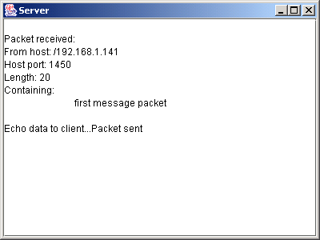
18.7 Connectionless Client/Server Interaction with Datagrams
Connectionless transmission with datagrams
  No connection maintained with other computer
  Break message into equal sized pieces and send as packets
  Message arrive in order, out of order or not at all
  Receiver puts messages in order and reads them

Slide 26
Server.java
Line 11
Line 26
1 // Fig. 18.6: Server.java
2 // Server that receives and sends packets from/to a client.
3 import java.io.*;
4 import java.net.*;
5 import java.awt.*;
6 import java.awt.event.*;
7 import javax.swing.*;
8
9 public class Server extends JFrame {
10 private JTextArea displayArea;
11 private DatagramSocket socket;
12
13 // set up GUI and DatagramSocket
14 public Server()
15 {
16 super( "Server" );
17
18 displayArea = new JTextArea();
19 getContentPane().add( new JScrollPane( displayArea ),
20 BorderLayout.CENTER );
21 setSize( 400, 300 );
22 setVisible( true );
23
24 // create DatagramSocket for sending and receiving packets
25 try {
26 socket = new DatagramSocket( 5000 );
27 }
Use a DatagramSocket as our server
The socket will listen on port 5000

Slide 27
Server.java
Lines 47-48
Line 50
28
29 // process problems creating DatagramSocket
30 catch( SocketException socketException ) {
31 socketException.printStackTrace();
32 System.exit( 1 );
33 }
34
35 } // end Server constructor
36
37 // wait for packets to arrive, display data and echo packet to client
38 private void waitForPackets()
39 {
40 while ( true ) { // loop forever
41
42 // receive packet, display contents, return copy to client
43 try {
44
45 // set up packet
46 byte data[] = new byte[ 100 ];
47 DatagramPacket receivePacket =
48 new DatagramPacket( data, data.length );
49
50 socket.receive( receivePacket ); // wait for packet
51
Create a DatagramPacket to store received information
Method receive blocks until a packet is received

Slide 28
Server.java
Line 54
Line 55
Line 56
Line 57
52 // display information from received packet
53 displayMessage( "\nPacket received:" +
54 "\nFrom host: " + receivePacket.getAddress() +
55 "\nHost port: " + receivePacket.getPort() +
56 "\nLength: " + receivePacket.getLength() +
57 "\nContaining:\n\t" + new String( receivePacket.getData(),
58 0, receivePacket.getLength() ) );
59
60 sendPacketToClient( receivePacket ); // send packet to client
61 }
62
63 // process problems manipulating packet
64 catch( IOException ioException ) {
65 displayMessage( ioException.toString() + "\n" );
66 ioException.printStackTrace();
67 }
68
69 } // end while
70
71 } // end method waitForPackets
72
73 // echo packet to client
74 private void sendPacketToClient( DatagramPacket receivePacket )
75 throws IOException
76 {
Method getAddress returns name of computer that sent packet
Method getPort returns the port the packet came through
Method getLength returns the length of the message sent
Method getData returns a byte array containing the sent data

Slide 29
Server.java
Lines 80-82
Line 84
77 displayMessage( "\n\nEcho data to client..." );
78
79 // create packet to send
80 DatagramPacket sendPacket = new DatagramPacket(
81 receivePacket.getData(), receivePacket.getLength(),
82 receivePacket.getAddress(), receivePacket.getPort() );
83
84 socket.send( sendPacket ); // send packet
85 displayMessage( "Packet sent\n" );
86 }
87
88 // utility method called from other threads to manipulate
89 // displayArea in the event-dispatch thread
90 private void displayMessage( final String messageToDisplay )
91 {
92 // display message from event-dispatch thread of execution
93 SwingUtilities.invokeLater(
94 new Runnable() { // inner class to ensure GUI updates properly
95
96 public void run() // updates displayArea
97 {
98 displayArea.append( messageToDisplay );
99 displayArea.setCaretPosition(
100 displayArea.getText().length() );
101 }
Create packet to be sent
Method send sends the packet over the network

Slide 30
Server.java
102
103 } // end inner class
104
105 ); // end call to SwingUtilities.invokeLater
106 }
107
108 public static void main( String args[] )
109 {
110 Server application = new Server();
111 application.setDefaultCloseOperation( JFrame.EXIT_ON_CLOSE );
112 application.waitForPackets();
113 }
114
115 } // end class Server

Slide 31
Client.java
Line 12
1 // Fig. 18.7: Client.java
2 // Client that sends and receives packets to/from a server.
3 import java.io.*;
4 import java.net.*;
5 import java.awt.*;
6 import java.awt.event.*;
7 import javax.swing.*;
8
9 public class Client extends JFrame {
10 private JTextField enterField;
11 private JTextArea displayArea;
12 private DatagramSocket socket;
13
14 // set up GUI and DatagramSocket
15 public Client()
16 {
17 super( "Client" );
18
19 Container container = getContentPane();
20
21 enterField = new JTextField( "Type message here" );
22 enterField.addActionListener(
23 new ActionListener() {
24 public void actionPerformed( ActionEvent event )
25 {
Use a DatagramSocket as our client

Slide 32
Client.java
Line 33
Lines 36-37
Line 39
26 // create and send packet
27 try {
28 displayArea.append( "\nSending packet containing: " +
29 event.getActionCommand() + "\n" );
30
31 // get message from textfield and convert to byte array
32 String message = event.getActionCommand();
33 byte data[] = message.getBytes();
34
35 // create sendPacket
36 DatagramPacket sendPacket = new DatagramPacket( data,
37 data.length, InetAddress.getLocalHost(), 5000 );
38
39 socket.send( sendPacket ); // send packet
40 displayArea.append( "Packet sent\n" );
41 displayArea.setCaretPosition(
42 displayArea.getText().length() );
43 }
44
45 // process problems creating or sending packet
46 catch ( IOException ioException ) {
47 displayMessage( ioException.toString() + "\n" );
48 ioException.printStackTrace();
49 }
50
Convert the String to a byte array
Create the DatagramPacket to send
Method send sends the packet over the network

Slide 33
Client.java
Line 68
51 } // end actionPerformed
52
53 } // end inner class
54
55 ); // end call to addActionListener
56
57 container.add( enterField, BorderLayout.NORTH );
58
59 displayArea = new JTextArea();
60 container.add( new JScrollPane( displayArea ),
61 BorderLayout.CENTER );
62
63 setSize( 400, 300 );
64 setVisible( true );
65
66 // create DatagramSocket for sending and receiving packets
67 try {
68 socket = new DatagramSocket();
69 }
70
71 // catch problems creating DatagramSocket
72 catch( SocketException socketException ) {
73 socketException.printStackTrace();
74 System.exit( 1 );
75 }
Create a DatagramSocket for sending and receiving packets

Slide 34
Client.java
Lines 89-90
Line 92
Line 96
Line 97
Line 98
Line 99
76
77 } // end Client constructor
78
79 // wait for packets to arrive from Server, display packet contents
80 private void waitForPackets()
81 {
82 while ( true ) { // loop forever
83
84 // receive packet and display contents
85 try {
86
87 // set up packet
88 byte data[] = new byte[ 100 ];
89 DatagramPacket receivePacket = new DatagramPacket(
90 data, data.length );
91
92 socket.receive( receivePacket ); // wait for packet
93
94 // display packet contents
95 displayMessage( "\nPacket received:" +
96 "\nFrom host: " + receivePacket.getAddress() +
97 "\nHost port: " + receivePacket.getPort() +
98 "\nLength: " + receivePacket.getLength() +
99 "\nContaining:\n\t" + new String( receivePacket.getData(),
100 0, receivePacket.getLength() ) );
101 }
Create a DatagramPacket to store received information
Method receive blocks until a packet is received
Method getAddress returns name of computer that sent packet
Method getPort returns the port the packet came through
Method getLength returns the length of the message sent
Method getData returns a byte array containing the sent data

Slide 35
Client.java
102
103 // process problems receiving or displaying packet
104 catch( IOException exception ) {
105 displayMessage( exception.toString() + "\n" );
106 exception.printStackTrace();
107 }
108
109 } // end while
110
111 } // end method waitForPackets
112
113 // utility method called from other threads to manipulate
114 // displayArea in the event-dispatch thread
115 private void displayMessage( final String messageToDisplay )
116 {
117 // display message from event-dispatch thread of execution
118 SwingUtilities.invokeLater(
119 new Runnable() { // inner class to ensure GUI updates properly
120
121 public void run() // updates displayArea
122 {
123 displayArea.append( messageToDisplay );
124 displayArea.setCaretPosition(
125 displayArea.getText().length() );
126 }

Slide 36
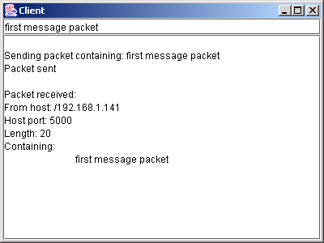
Client.java
127
128 } // end inner class
129
130 ); // end call to SwingUtilities.invokeLater
131 }
132
133 public static void main( String args[] )
134 {
135 Client application = new Client();
136 application.setDefaultCloseOperation( JFrame.EXIT_ON_CLOSE );
137 application.waitForPackets();
138 }
139
140 } // end class Client

Slide 37
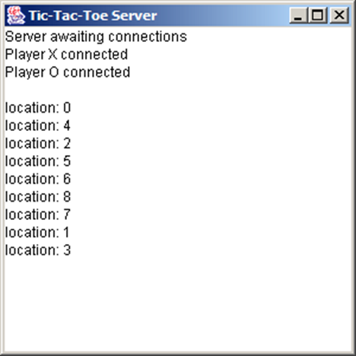
18.8 Client/Server Tic-Tac-Toe Using a Multithreaded Server
Multiple threads
  Server uses one thread per player
    Allow each player to play game independently

Slide 38
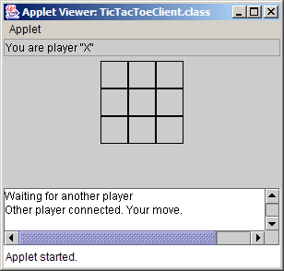
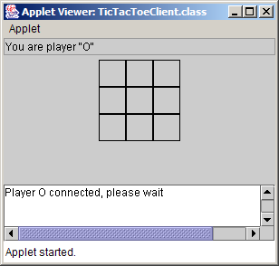
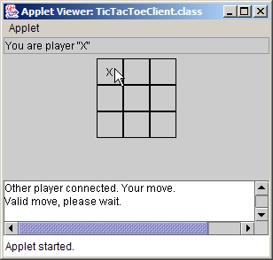
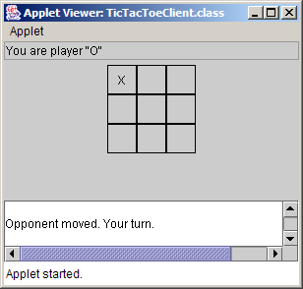
TicTacToeClient.java

Slide 39
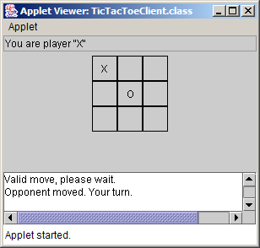
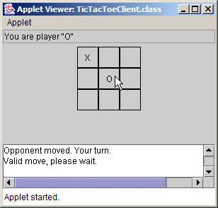
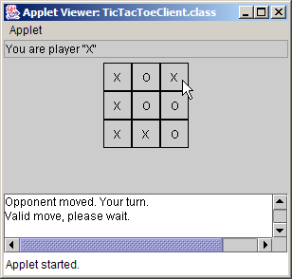
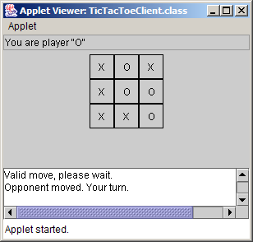
TicTacToeClient.java

Slide 40
TicTacToeServer.java
1 // Fig. 18.8: TicTacToeServer.java
2 // This class maintains a game of Tic-Tac-Toe for two client applets.
3 import java.awt.*;
4 import java.awt.event.*;
5 import java.net.*;
6 import java.io.*;
7 import javax.swing.*;
8
9 public class TicTacToeServer extends JFrame {
10 private char[] board;
11 private JTextArea outputArea;
12 private Player[] players;
13 private ServerSocket server;
14 private int currentPlayer;
15 private final int PLAYER_X = 0, PLAYER_O = 1;
16 private final char X_MARK = 'X', O_MARK = 'O';
17
18 // set up tic-tac-toe server and GUI that displays messages
19 public TicTacToeServer()
20 {
21 super( "Tic-Tac-Toe Server" );
22
23 board = new char[ 9 ];
24 players = new Player[ 2 ];
25 currentPlayer = PLAYER_X;

Slide 41
TicTacToeServer.java
Line 29
Line 49
26
27 // set up ServerSocket
28 try {
29 server = new ServerSocket( 12345, 2 );
30 }
31
32 // process problems creating ServerSocket
33 catch( IOException ioException ) {
34 ioException.printStackTrace();
35 System.exit( 1 );
36 }
37
38 // set up JTextArea to display messages during execution
39 outputArea = new JTextArea();
40 getContentPane().add( outputArea, BorderLayout.CENTER );
41 outputArea.setText( "Server awaiting connections\n" );
42
43 setSize( 300, 300 );
44 setVisible( true );
45
46 } // end TicTacToeServer constructor
47
48 // wait for two connections so game can be played
49 public void execute()
50 {
Create ServerSocket to listen on port 12345
Method execute waits for two connections to start game

Slide 42
TicTacToeServer.java
Line 56
Line 57
51 // wait for each client to connect
52 for ( int i = 0; i < players.length; i++ ) {
53
54 // wait for connection, create Player, start thread
55 try {
56 players[ i ] = new Player( server.accept(), i );
57 players[ i ].start();
58 }
59
60 // process problems receiving connection from client
61 catch( IOException ioException ) {
62 ioException.printStackTrace();
63 System.exit( 1 );
64 }
65 }
66
67 // Player X is suspended until Player O connects.
68 // Resume player X now.
69 synchronized ( players[ PLAYER_X ] ) {
70 players[ PLAYER_X ].setSuspended( false );
71 players[ PLAYER_X ].notify();
72 }
73
74 } // end method execute
75
Block while waiting for each player
Call start method to begin executing thread

Slide 43
TicTacToeServer.java
76 // utility method called from other threads to manipulate
77 // outputArea in the event-dispatch thread
78 private void displayMessage( final String messageToDisplay )
79 {
80 // display message from event-dispatch thread of execution
81 SwingUtilities.invokeLater(
82 new Runnable() { // inner class to ensure GUI updates properly
83
84 public void run() // updates outputArea
85 {
86 outputArea.append( messageToDisplay );
87 outputArea.setCaretPosition(
88 outputArea.getText().length() );
89 }
90
91 } // end inner class
92
93 ); // end call to SwingUtilities.invokeLater
94 }
95
96 // Determine if a move is valid. This method is synchronized because
97 // only one move can be made at a time.
98 public synchronized boolean validateAndMove( int location, int player )
99 {
100 boolean moveDone = false;
101

Slide 44
TicTacToeServer.java
102 // while not current player, must wait for turn
103 while ( player != currentPlayer ) {
104
105 // wait for turn
106 try {
107 wait();
108 }
109
110 // catch wait interruptions
111 catch( InterruptedException interruptedException ) {
112 interruptedException.printStackTrace();
113 }
114 }
115
116 // if location not occupied, make move
117 if ( !isOccupied( location ) ) {
118
119 // set move in board array
120 board[ location ] = currentPlayer == PLAYER_X ? X_MARK : O_MARK;
121
122 // change current player
123 currentPlayer = ( currentPlayer + 1 ) % 2;
124
125 // let new current player know that move occurred
126 players[ currentPlayer ].otherPlayerMoved( location );
127

Slide 45
TicTacToeServer.java
128 notify(); // tell waiting player to continue
129
130 // tell player that made move that the move was valid
131 return true;
132 }
133
134 // tell player that made move that the move was not valid
135 else
136 return false;
137
138 } // end method validateAndMove
139
140 // determine whether location is occupied
141 public boolean isOccupied( int location )
142 {
143 if ( board[ location ] == X_MARK || board [ location ] == O_MARK )
144 return true;
145 else
146 return false;
147 }
148
149 // place code in this method to determine whether game over
150 public boolean isGameOver()
151 {
152 return false; // this is left as an exercise
153 }

Slide 46
TicTacToeServer.java
154
155 public static void main( String args[] )
156 {
157 TicTacToeServer application = new TicTacToeServer();
158 application.setDefaultCloseOperation( JFrame.EXIT_ON_CLOSE );
159 application.execute();
160 }
161
162 // private inner class Player manages each Player as a thread
163 private class Player extends Thread {
164 private Socket connection;
165 private DataInputStream input;
166 private DataOutputStream output;
167 private int playerNumber;
168 private char mark;
169 protected boolean suspended = true;
170
171 // set up Player thread
172 public Player( Socket socket, int number )
173 {
174 playerNumber = number;
175
176 // specify player's mark
177 mark = ( playerNumber == PLAYER_X ? X_MARK : O_MARK );
178

Slide 47
TicTacToeServer.java
Lines 183-184
Lines 200-201
179 connection = socket;
180
181 // obtain streams from Socket
182 try {
183 input = new DataInputStream( connection.getInputStream() );
184 output = new DataOutputStream( connection.getOutputStream() );
185 }
186
187 // process problems getting streams
188 catch( IOException ioException ) {
189 ioException.printStackTrace();
190 System.exit( 1 );
191 }
192
193 } // end Player constructor
194
195 // send message that other player moved
196 public void otherPlayerMoved( int location )
197 {
198 // send message indicating move
199 try {
200 output.writeUTF( "Opponent moved" );
201 output.writeInt( location );
202 }
203
Get the streams to send and receive data
Send output notifying the other player of the move

Slide 48
TicTacToeServer.java
Line 219
Line 227
204 // process problems sending message
205 catch ( IOException ioException ) {
206 ioException.printStackTrace();
207 }
208 }
209
210 // control thread's execution
211 public void run()
212 {
213 // send client message indicating its mark (X or O),
214 // process messages from client
215 try {
216 displayMessage( "Player " + ( playerNumber ==
217 PLAYER_X ? X_MARK : O_MARK ) + " connected\n" );
218
219 output.writeChar( mark ); // send player's mark
220
221 // send message indicating connection
222 output.writeUTF( "Player " + ( playerNumber == PLAYER_X ?
223 "X connected\n" : "O connected, please wait\n" ) );
224
225 // if player X, wait for another player to arrive
226 if ( mark == X_MARK ) {
227 output.writeUTF( "Waiting for another player" );
228
Send player’s mark
Wait for other player

Slide 49
TicTacToeServer.java
Line 244
Line 251
229 // wait for player O
230 try {
231 synchronized( this ) {
232 while ( suspended )
233 wait();
234 }
235 }
236
237 // process interruptions while waiting
238 catch ( InterruptedException exception ) {
239 exception.printStackTrace();
240 }
241
242 // send message that other player connected and
243 // player X can make a move
244 output.writeUTF( "Other player connected. Your move." );
245 }
246
247 // while game not over
248 while ( ! isGameOver() ) {
249
250 // get move location from client
251 int location = input.readInt();
252
Begin the game
Read a move

Slide 50
TicTacToeServer.java
Line 256
253 // check for valid move
254 if ( validateAndMove( location, playerNumber ) ) {
255 displayMessage( "\nlocation: " + location );
256 output.writeUTF( "Valid move." );
257 }
258 else
259 output.writeUTF( "Invalid move, try again" );
260 }
261
262 connection.close(); // close connection to client
263
264 } // end try
265
266 // process problems communicating with client
267 catch( IOException ioException ) {
268 ioException.printStackTrace();
269 System.exit( 1 );
270 }
271
272 } // end method run
273
274 // set whether or not thread is suspended
275 public void setSuspended( boolean status )
276 {
277 suspended = status;
278 }
Send message to client

Slide 51

TicTacToeServer.java
279
280 } // end class Player
281
282 } // end class TicTacToeServer

Slide 52
TicTacToeClient.java
1 // Fig. 18.9: TicTacToeClient.java
2 // Client that let a user play Tic-Tac-Toe with another across a network.
3 import java.awt.*;
4 import java.awt.event.*;
5 import java.net.*;
6 import java.io.*;
7 import javax.swing.*;
8
9 public class TicTacToeClient extends JApplet implements Runnable {
10 private JTextField idField;
11 private JTextArea displayArea;
12 private JPanel boardPanel, panel2;
13 private Square board[][], currentSquare;
14 private Socket connection;
15 private DataInputStream input;
16 private DataOutputStream output;
17 private char myMark;
18 private boolean myTurn;
19 private final char X_MARK = 'X', O_MARK = 'O';
20
21 // Set up user-interface and board
22 public void init()
23 {
24 Container container = getContentPane();
25

Slide 53
TicTacToeClient.java
26 // set up JTextArea to display messages to user
27 displayArea = new JTextArea( 4, 30 );
28 displayArea.setEditable( false );
29 container.add( new JScrollPane( displayArea ), BorderLayout.SOUTH );
30
31 // set up panel for squares in board
32 boardPanel = new JPanel();
33 boardPanel.setLayout( new GridLayout( 3, 3, 0, 0 ) );
34
35 // create board
36 board = new Square[ 3 ][ 3 ];
37
38 // When creating a Square, the location argument to the constructor
39 // is a value from 0 to 8 indicating the position of the Square on
40 // the board. Values 0, 1, and 2 are the first row, values 3, 4,
41 // and 5 are the second row. Values 6, 7, and 8 are the third row.
42 for ( int row = 0; row < board.length; row++ ) {
43
44 for ( int column = 0; column < board[ row ].length; column++ ) {
45
46 // create Square
47 board[ row ][ column ] = new Square( ' ', row * 3 + column );
48 boardPanel.add( board[ row ][ column ] );
49 }
50 }
51

Slide 54
TicTacToeClient.java
Line 73
Lines 76-77
52 // textfield to display player's mark
53 idField = new JTextField();
54 idField.setEditable( false );
55 container.add( idField, BorderLayout.NORTH );
56
57 // set up panel to contain boardPanel (for layout purposes)
58 panel2 = new JPanel();
59 panel2.add( boardPanel, BorderLayout.CENTER );
60 container.add( panel2, BorderLayout.CENTER );
61
62 } // end method init
63
64 // Make connection to server and get associated streams.
65 // Start separate thread to allow this applet to
66 // continually update its output in textarea display.
67 public void start()
68 {
69 // connect to server, get streams and start outputThread
70 try {
71
72 // make connection
73 connection = new Socket( getCodeBase().getHost(), 12345 );
74
75 // get streams
76 input = new DataInputStream( connection.getInputStream() );
77 output = new DataOutputStream( connection.getOutputStream() );
Connect to the server
Get the streams to send and receive data

Slide 55
TicTacToeClient.java
Line 96
78 }
79
80 // catch problems setting up connection and streams
81 catch ( IOException ioException ) {
82 ioException.printStackTrace();
83 }
84
85 // create and start output thread
86 Thread outputThread = new Thread( this );
87 outputThread.start();
88
89 } // end method start
90
91 // control thread that allows continuous update of displayArea
92 public void run()
93 {
94 // get player's mark (X or O)
95 try {
96 myMark = input.readChar();
97
98 // display player ID in event-dispatch thread
99 SwingUtilities.invokeLater(
100 new Runnable() {
101 public void run()
102 {
Read mark character from server

Slide 56
TicTacToeClient.java
Line 111
Line 112
103 idField.setText( "You are player \"" + myMark + "\"" );
104 }
105 }
106 );
107
108 myTurn = ( myMark == X_MARK ? true : false );
109
110 // receive messages sent to client and output them
111 while ( true ) {
112 processMessage( input.readUTF() );
113 }
114
115 } // end try
116
117 // process problems communicating with server
118 catch ( IOException ioException ) {
119 ioException.printStackTrace();
120 }
121
122 } // end method run
123
124 // process messages received by client
125 private void processMessage( String message )
126 {
Loop continually
Read and process messages from server

Slide 57
TicTacToeClient.java
Line 128
Line 134
Line 140
127 // valid move occurred
128 if ( message.equals( "Valid move." ) ) {
129 displayMessage( "Valid move, please wait.\n" );
130 setMark( currentSquare, myMark );
131 }
132
133 // invalid move occurred
134 else if ( message.equals( "Invalid move, try again" ) ) {
135 displayMessage( message + "\n" );
136 myTurn = true;
137 }
138
139 // opponent moved
140 else if ( message.equals( "Opponent moved" ) ) {
141
142 // get move location and update board
143 try {
144 int location = input.readInt();
145 int row = location / 3;
146 int column = location % 3;
147
148 setMark( board[ row ][ column ],
149 ( myMark == X_MARK ? O_MARK : X_MARK ) );
150 displayMessage( "Opponent moved. Your turn.\n" );
151 myTurn = true;
If valid move, write message and set mark in square
If invalid move, display message
If opponent moves, set mark in square

Slide 58
TicTacToeClient.java
152
153 } // end try
154
155 // process problems communicating with server
156 catch ( IOException ioException ) {
157 ioException.printStackTrace();
158 }
159
160 } // end else if
161
162 // simply display message
163 else
164 displayMessage( message + "\n" );
165
166 } // end method processMessage
167
168 // utility method called from other threads to manipulate
169 // outputArea in the event-dispatch thread
170 private void displayMessage( final String messageToDisplay )
171 {
172 // display message from event-dispatch thread of execution
173 SwingUtilities.invokeLater(
174 new Runnable() { // inner class to ensure GUI updates properly
175

Slide 59
TicTacToeClient.java
176 public void run() // updates displayArea
177 {
178 displayArea.append( messageToDisplay );
179 displayArea.setCaretPosition(
180 displayArea.getText().length() );
181 }
182
183 } // end inner class
184
185 ); // end call to SwingUtilities.invokeLater
186 }
187
188 // utility method to set mark on board in event-dispatch thread
189 private void setMark( final Square squareToMark, final char mark )
190 {
191 SwingUtilities.invokeLater(
192 new Runnable() {
193 public void run()
194 {
195 squareToMark.setMark( mark );
196 }
197 }
198 );
199 }
200

Slide 60
TicTacToeClient.java
Line 208
201 // send message to server indicating clicked square
202 public void sendClickedSquare( int location )
203 {
204 if ( myTurn ) {
205
206 // send location to server
207 try {
208 output.writeInt( location );
209 myTurn = false;
210 }
211
212 // process problems communicating with server
213 catch ( IOException ioException ) {
214 ioException.printStackTrace();
215 }
216 }
217 }
218
219 // set current Square
220 public void setCurrentSquare( Square square )
221 {
222 currentSquare = square;
223 }
224
Send the move to the server

Slide 61
TicTacToeClient.java
225 // private inner class for the squares on the board
226 private class Square extends JPanel {
227 private char mark;
228 private int location;
229
230 public Square( char squareMark, int squareLocation )
231 {
232 mark = squareMark;
233 location = squareLocation;
234
235 addMouseListener(
236 new MouseAdapter() {
237 public void mouseReleased( MouseEvent e )
238 {
239 setCurrentSquare( Square.this );
240 sendClickedSquare( getSquareLocation() );
241 }
242 }
243 );
244
245 } // end Square constructor
246
247 // return preferred size of Square
248 public Dimension getPreferredSize()
249 {

Slide 62
TicTacToeClient.java
250 return new Dimension( 30, 30 );
251 }
252
253 // return minimum size of Square
254 public Dimension getMinimumSize()
255 {
256 return getPreferredSize();
257 }
258
259 // set mark for Square
260 public void setMark( char newMark )
261 {
262 mark = newMark;
263 repaint();
264 }
265
266 // return Square location
267 public int getSquareLocation()
268 {
269 return location;
270 }
271
272 // draw Square
273 public void paintComponent( Graphics g )
274 {

Slide 63
TicTacToeClient.java
275 super.paintComponent( g );
276
277 g.drawRect( 0, 0, 29, 29 );
278 g.drawString( String.valueOf( mark ), 11, 20 );
279 }
280
281 } // end inner-class Square
282
283 } // end class TicTacToeClient

Slide 64
TicTacToeClient.java

Slide 65
TicTacToeClient.java

